Slide 1
Michael Allen Sprint #4 Review
Perform Statistical Analysis on Somewhat Cleaned Data from “End Of Course Survey” and Create Bar Graphs of the Results

Slide 2
Game Plan
Take a Somewhat Cleaned CSV “End of Course Survey” file and “Read” into R
(In reality actually working with the original dirty data)
2. Then Write a Script to:
Change the Categorical Data to Specific Numerical Data
Perform Mean Calculations Per Question (Column)
Perform Standard Deviation Calculations Per Question (Column)
View Just the Results in R
Output to a PDF file a Bar Graph of the Means Per Question
Output to a PDF file a Bar Graph of the Standard Deviation Per Question
Write All of the Analysis Data back to a CSV file

Slide 3
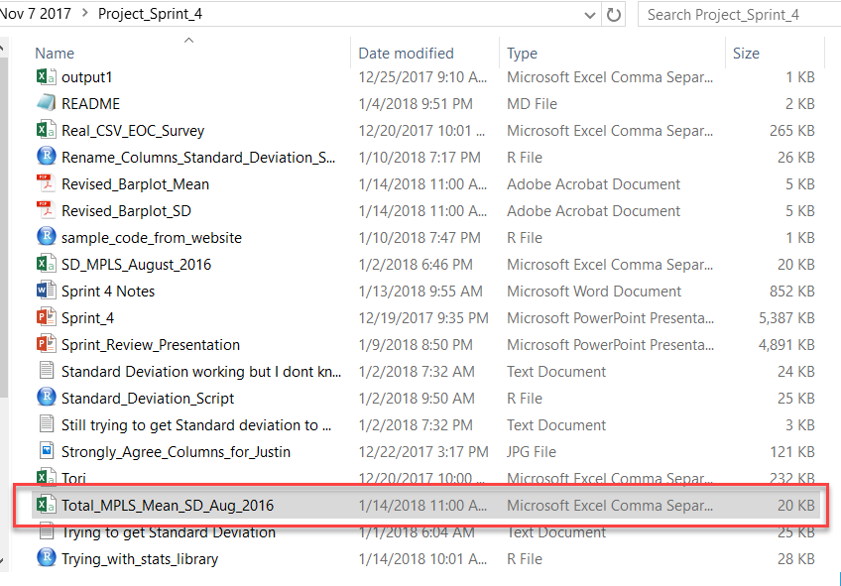

Write the R Completed Analysis Data Back to a CSV File
write.csv(Total_MPLS_Mean_SD_Aug_2016, "Total_MPLS_Mean_SD_Aug_2016.csv")

Slide 4
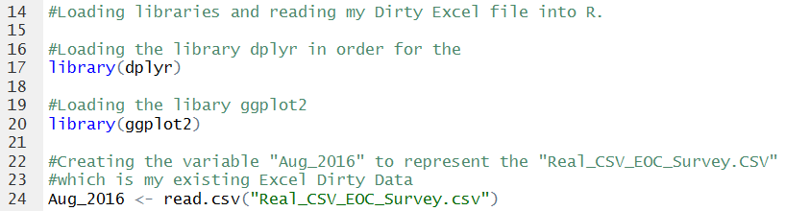
Create a Script in R to Perform Statistical Analysis & Output Bar Graphs

Slide 5
Viewing the in R

Slide 6
Thank you

